Slide 1
Modeling Computation
Chapter 13
© 2019 McGraw-Hill Education. All rights reserved. Authorized only for instructor use in the classroom. No reproduction or further distribution permitted without the prior written consent of McGraw-Hill Education.

Slide 2
Chapter Summary
Languages and Grammars
Finite-State Machines with Output
Finite-State Machines with No Output
Language Recognition
Turing Machines

Slide 3
Languages and Grammars
Section 13.1

Slide 4
Section Summary 1
Phrase-Structure Grammars
Types of Phrase-Structure Grammars
Derivation Trees
Backus-Naur Form

Slide 5
Introduction 1
Syntax (form of a sentence) vs. semantics (meaning of a sentence)
The sentence the frog writes neatly is a valid sentence according to the rules of English grammar. That is, it is syntactically correct, even though it’s nonsensical (unless we are talking about a fantasy world).
The sequence of words swims quickly mathematics is not a valid sentence according to the rules of English grammar.

Slide 6
Grammars
The rules that specify the syntactically correct sentences of a natural language such as English are complex.
Instead of studying natural languages, we can define formal languages that have well-defined rules of syntax.
These rules of syntax are important both in linguistics (the study of natural languages) and in the study of programming languages.

Slide 7
An Example Grammar
a sentence is made up of a noun phrase followed by a verb phrase;
a noun phrase is made up of an article followed by an adjective followed by a noun, or
a noun phrase is made up of an article followed by a noun;
a verb phrase is made up of a verb followed by an adverb, or
a verb phrase is made up of a verb;
an article is a, or
an article is the;
an adjective is large, or
an adjective is hungry;
a noun is rabbit, or
a noun is mathematician;
a verb is eats, or
a verb is hops;
an adverb is quickly, or
an adverb is wildly.
We use these rules to form valid sentences by making a series of replacements until no more rules can be used.
An example sequence of replacements:
noun phrase verb phrase
article adjective noun verb phrase
article adjective noun verb adverb
the adjective noun verb adverb
the large noun verb adverb
the large rabbit verb adverb
the large rabbit hops adverb
the large rabbit hops quickly
Some additional valid sentences are:
a hungry mathematician eats wildly,
a large mathematician hops,
the rabbit eats quickly, etc.
But note that the following is not valid:
the quickly eats mathematician

Slide 8
Phrase-Structure Grammars 1
A vocabulary (or alphabet) V is a finite, nonempty set of elements called symbols.
A word (or sentence) over V is a string of finite length of elements of V.
The empty string or null string, denoted by λ, is the string containing no symbols.
The set of all words over V is denoted by V*. A language over V is a subset of V*.
The elements of V that can not be replaced by other symbols are called terminals, e.g., a, the, and rabbit in the example grammar.
Those that can be replaced by other symbols are called nonterminals, e.g., sentence, noun phrase, etc.
The rules that specify when we can replace a string V* with another string are called productions of the grammar. We denote by z₀ → z₁ the production that specifies that z₀ can be replaced by z₁ within a string.

Slide 9
Phrase-Structure Grammars 2
A phrase-structure grammar G =(V, T, S, P) consists of a vocabulary V, a subset T of V consisting of terminal symbols, a start symbol S from V, and a finite set of productions P.
The set N = V − T is the set of nonterminal symbols.
Every production in P must contain at least one nonterminal on its left side.
Example (Grammar 1): Let G =(V, T, S, P), where V = {a, b, A, B, S}, T = {a,b}, S is the start symbol, and P = {S →Aba, A →BB, B →ab, AB →b}.

Slide 10
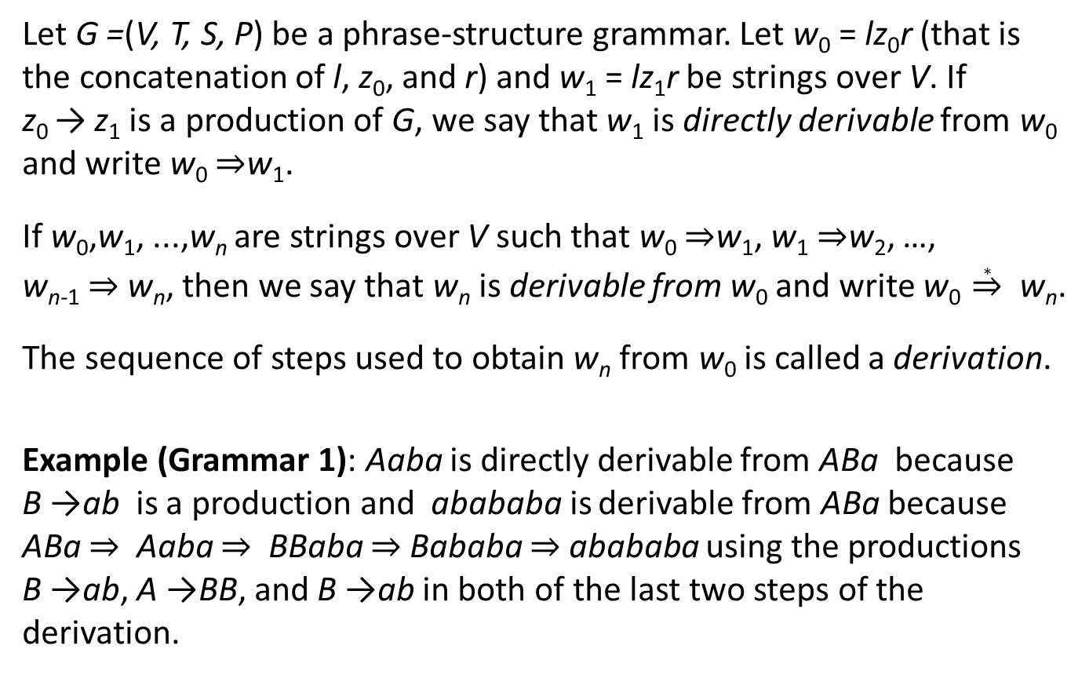
Derivations
Let G =(V, T, S, P) be a phrase-structure grammar. Let w₀ = lz₀r (that is the concatenation of l, z₀, and r) and w₁ = lz₁r be strings over V. If z₀ → z₁ is a production of G, we say that w₁ is directly derivable from w₀ and write w₀ ⇒w₁.
If w₀,w₁, ...,w_{n} are strings over V such that w₀ ⇒w₁, w₁ ⇒w₂, …, w_{n-1} ⇒ w_{n}, then we say that w_{n} is derivable from w₀ and write w₀ $\underset{⇒}{∗}$ w_{n}.
The sequence of steps used to obtain w_{n} from w₀ is called a derivation.
Example (Grammar 1): Aaba is directly derivable from ABa because B →ab is a production and abababa is derivable from ABa because ABa ⇒ Aaba ⇒ BBaba ⇒ Bababa ⇒ abababa using the productions B →ab, A →BB, and B →ab in both of the last two steps of the derivation.

Slide 11
Language Generation
Let G =(V, T, S, P) be a phrase-structure grammar. The language generated by G, denoted by L(G), is the set of all strings or terminals that are derivable from the starting state S.
In other words,
Let G be the grammar with the vocabulary V = {S, A, a, b}, a set of terminals T = {a, b}, starting symbol S, and productions
L(G) = {b, aaa}, because we can begin a derivation with S → aA or with S → b, and from aA we can derive aaa using A → aa. There are no other possible derivations.

Slide 12
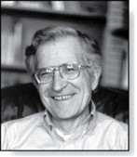
Types of Phrase Structure Grammars
Phrase-structure grammars are classified by the types of allowable productions.
Avram Noam Chomsky (Born 1928)
TABLE 1 Types of Grammars.
Type | Restrictions on Productions w₁ → w₂
0 | No restrictions
1 | w₁ = lAr and w₂ = lwr, where A ∊ N, l, r,w ∊ (N ∪ T)∗ and w ≠ 𝜆; or w₁ = S and w₂ = 𝜆 as long as S is not on the right-hand side of another production
2 | w₁ = A, where A is a nonterminal symbol
3 | w₁ = A and w₂ = aB or w₂ = a, where A ∊ N, B ∊ N, and a ∊ T; or w₁ = S and w₂ = 𝜆
Type 2 grammars are called context-free grammars. A language generated by a context-free grammar is called a context-free language.
Type 3 grammars are called context-sensitive grammars (or a regular grammar). A language generated by a context-sensitive grammar is called a context-sensitive language (or a regular language).

Slide 13
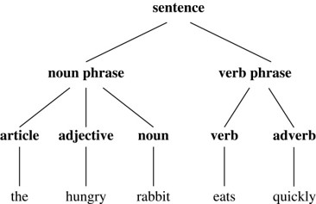
Derivation Trees
We can represent a derivation in the language generated by a context-free grammar by an ordered rooted tree, called a derivation, or parse tree.
The root of the tree represents the start symbol.
The internal vertices represent the nonterminal symbols that arise in the derivation.
The leaves represent the terminal symbols that arise.
If the production A →w, where w is a word, arises in the derivation, the vertex that represents A has as children vertices that represent each symbol in w, in order from left to right.
A derivation tree for the derivation of the hungry rabbit eats quickly, given the grammar described earlier.
Jump to long description

Slide 14
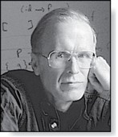
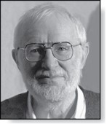
Backus-Naur Form
John Backus (1924-2007)
Peter Naur (Born 1928)
Backus-Naur form (BNF) is sometimes used to specify a type 2 grammar. It is often used to specify the syntactic rules of computer languages.
The productions of a type 2 grammar have a single nonterminal symbol on their left-hand side.
All the productions with the same nonterminal symbol on the left-hand side are combined into one statement using the symbol ::= instead of →. Additionally, all nonterminal symbols are enclosed in brackets (〈〉), and the right-hand side of productions are separated by bars.
For example, the productions A →Aa, A →a, and A →AB are written as

Slide 15
BNF and ALGOL 60
In the programming language ALGOL 60 an identifier consists of a string of alphanumeric characters and must begin with a letter.
The BNF description of allowable identifiers is:
x99a is a valid identifier since the first rule can be used to replace 〈identifier〉 by 〈identifier〉〈letter〉 , the second rule to obtain 〈identifier〉 a, the first rule twice to obtain 〈identifier〉〈digit〉〈digit〉 a, the third rule twice to obtain 〈identifier〉99a, the first rule to obtain 〈letter〉99a, and finally the second rule to obtain x99a.

Slide 16
Finite-State Machines with Output
Section 13.2

Slide 17
Section Summary 2
Finite-State Machines (FSMs) with Outputs
Types of Finite-State Machines with Outputs (not currently included in overheads)

Slide 18
Introduction 2
Many kinds of machines, including computers, can be modeled using a structure called a finite-state machine (or finite automaton).
A finite-state machine consists of a finite set of states, a designated start state, an input alphabet, and a transition function that assigns a next state to every (state, input) pair
As we will see in Sections 13.2 − 13.4, some types of finite-state machines produce output, while for other types of finite-state machines that do not produce output some states are designated as accepting states.
Finite-state machines are used in many diverse applications, including spell-checking programs, grammar checking, indexing, searching large bodies of text, speech recognition, XML, HTML, and network protocols

Slide 19
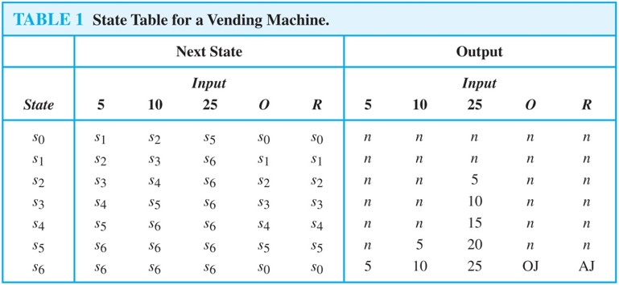
An Example of a Finite-State Machine with Output 1
A vending machine accepts nickels (5 cents) , dimes (10 cents) , and quarters (25 cents). When 30 cents or more has been deposited, the machine returns the amount over 30 cents. The customer can then press an orange button to receive a container of orange juice or a red button to receive a container of apple juice.
The machine can be in any of the states s_{i}, i = 0, …, 6, where s_{i} is the state where the machine has received 5i cents. The machine starts in state s₀, with 0 cents received. The possible inputs are 5 cents, 10 cents, 25 cents, the orange button (O), and the red button (R). The possible outputs are nothing (n), 5 cents, 15 cents, 20 cents, 25 cents, an orange juice, and an apple juice.

Slide 20
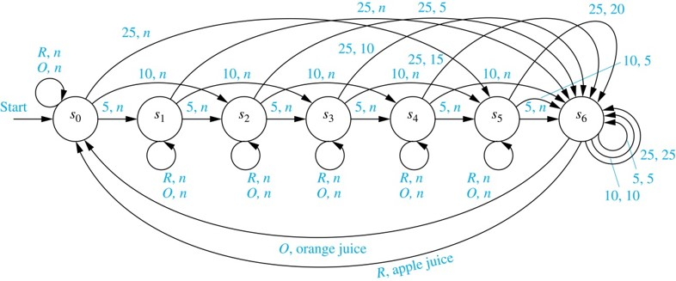
An Example of a Finite-State Machine with Output 2
We represent this vending machine using a directed graph with labeled edges, where each state is represented by a circle, edges represent transitions, and edges are labeled with the input and output for that transition.
We will trace the transitions and outputs of the vending machine when a student puts in a dime followed by a quarter, receives 5 cents back, and then pushes the orange button and receives an orange juice.
The machine starts in state s₀.
The first input is 10 cents, which changes the state to s₂ and gives no output.
After the second input of 25 cents, the state changes to s₆ and gives 5 cents as output.
The last input is the orange button, which changes the state back to s₀ and gives an orange juice as output.
Jump to long description

Slide 21
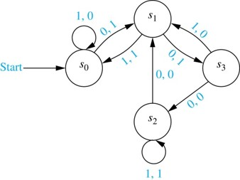
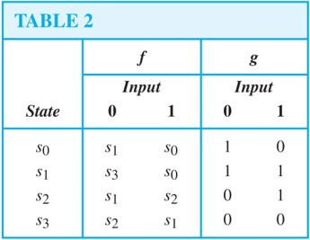
FSMs with Outputs
A finite-state machine M =(S, I, O, f, g, s₀) consists of a finite set S of states, a finite input alphabet I, a finite output alphabet O, a transition function f that assigns to each state and input pair a new state, an output function g that assigns to each state and input pair an output, and an initial state s₀ .
A state table is used to represent the values of the transition function f and the output function g for all (state, input).
Alternatively, a finite-state machine can be represented by a state diagram, which is a directed graph with labeled edges. Each state is represented by a circle, and arrows labeled with the input and output pair represent the transitions.
The state table and state diagram both represent the finite state machine with S = {s₀ ,s₁ ,s₂ ,s₃}, I = {0, 1}, and O = {0, 1}.
Jump to long description

Slide 22
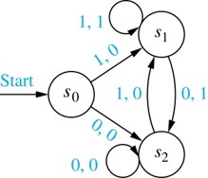
Unit-delay Machine
An important element in many electronic devices is a unit-delay machine, which produces as output the input string delayed by a specified amount of time, i.e., padded with an initial string of 0s.
How can a finite-state machine be constructed that delays an input string by one unit of time, that is, produces as output the bit string 0x₁x₂…x_{k-1} given the input bit string x₁x₂…x_{k-1}?
A delay machine can be constructed that has 0 or 1 as possible inputs. The machine has the start state s₀. The transition from s₀ produces an output of 0. The machine is in state s₁ if the previous input was a 1 and it produces 1 as output for its next transition, and in state s₂ if the previous input was 0 and it produces an output of 0 for its next transition.
Jump to long description

Slide 23
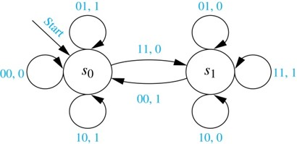
Addition Machine
We will construct a finite-state machine that adds two positive integers using their binary expansions.
Recall the conventional procedure to add (x_{n}…x₁x₀)₂ and (y_{n}…y₁y₀)₂ .
First, the bits x₀ and y₀ are added, producing a sum bit z₀ and a carry bit c₀. Next the bits x₁ and y₁ are added together with the carry bit c₀. This gives a sum bit z₁ and a carry bit c₁.
The procedure continues until the nth stage, where x_{n}, y_{n} and the previous carry c_{n-1} are added to produce the sum bit z_{n} and the carry bit c_{n}, which is equal to the sum bit z_{n+1}.
We can construct a finite state machine that uses just two states.
The start state s₀ is used to remember that the previous carry is 0.
The other state s₁ is used to remember that the previous carry is 1. (For simplicity, we assume that both x_{n} and y_{n} are 0.)
The inputs are pairs of bits. The transitions and the outputs are constructed from the sum of the two bits in the input and the carry represented by the state.
For example, when the machine is in state s₁ and receives 01 as input, the next state is s₁ and the output is 0, because the sum 0 + 1 + 1 =(10)₂.
Jump to long description

Slide 24
Finite-State Machines with No Output
Section 13.3

Slide 25
Section Summary 3
Set of Strings
Finite-State Automata
Language Recognition by Finite-State Machines
Designing Finite-State Automata
Equivalent Finite-State Automata (not currently included in overheads)
Nondeterministic Finite-State Automata

Slide 26
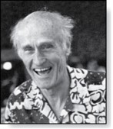
Set of Strings
Stephen Cole Kleene (1909-1994)
FSMs with no output, but with some states designated as accepting states, are specifically designed for recognizing languages.
The concatenation of A and B, where A and B are subsets of V*, denoted by AB, is the set of all strings of the form xy, where x is a string in A and y is a string in B.
Let A = {0, 11} and B = {1, 10, 110}. Then
AB = {01, 010, 0110, 111, 110, 11110} and
BA = {10, 111, 100, 1011, 1100, 11011}
If A is a subset of V*, the Kleene closure of A, denoted by A*, is the set consisting of arbitrarily long strings of elements of A. That is,
The Kleene closures of the sets A = {0}, B = {0,1} and C = {11} are

Slide 27
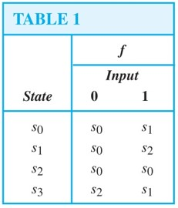
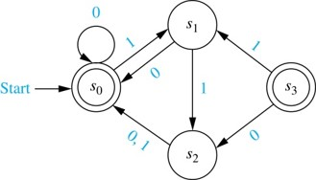
Finite-State Automata (FSA)
A finite-state automaton M = (S, I, f, s₀, F) consists of a finite set S of states, a finite input alphabet I, a transition function f that assigns a next state to every pair of state and input (so that f: S × I → S), an initial or start state s₀, and a subset F of S consisting of final (or accepting) states.
FSAs can be represented using either state tables or state diagrams, in which final states are indicated with a double circle.
The state diagram for the FSA M = (S, I, f, s₀, F), where S = {s₀, s₁, s₂,s₃}, I = {0, 1}, F = {s₀,s₃}, and the transition diagram is in Table 1, is shown here.
Jump to long description

Slide 28
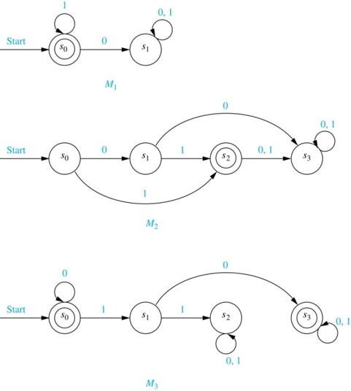
Language Recognition by FSAs 1
A string x is said to be recognized (or accepted) by the machine M = (S, I, f, s₀, F) if it takes the initial state s₀ to a final state, that is, f(s₀, x). The language recognized (or accepted) by M, denoted by L(M), is the set of all strings that are recognized by M. Two finite-state automata are called equivalent if they recognize the same language.
The only final state of M₁ is s₀. The strings that take s₀ to itself consist of zero or more consecutive 1s. Hence, L(M₁) = {1^{n} | n = 0, 1, 2, ….}.
The only final state of M₂ is s₂. The strings that take s₀ to s₂ are 1 and 01. Hence , L(M₂) = {1, 01}.
The final state of M₃ are s₀ and s₃. The strings that take s₀ to itself are λ, 0, 00, 000,… . The strings that take s₀ to s₃ are a string of zero or more consecutive 0s, followed by 10, followed by any string. Hence, L(M₃) = {0^{n},0^{n}10x | n = 0, 1, 2, …., and x is any string}
Jump to long description

Slide 29
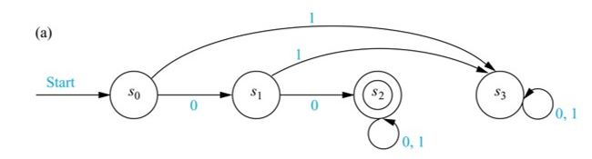
Language Recognition by FSAs 2
Example: Construct a FSA that recognizes the set of bit strings that begin with two 0s.
Solution:
Besides the start state s₀, we include a nonfinal state s₁; we move to s₁ from s₀ if the first bit is a 0.
Next, we add a final state s₂, which we move to from s₁, if the second bit is a 0. We stay in this state no matter what the succeeding bits (if any) are.
We need a nonfinal state s₃, so that we can move to it from s₀ if the first bit is a 1 and from s₁ if the second bit is a 1.
Jump to long description

Slide 30
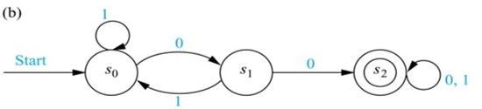
Language Recognition by FSAs 3
Example: Construct a FSA that recognizes the set of bit strings that contain two consecutive 0s.
Solution:
Besides the start state s₀, we include a nonfinal state s₁, which tells us that the last input bit seen is a 0, but either the bit before was a 1, or this is the initial bit.
Next, we add a final state s₂, which we move to from s₁, if the next bit after a 0 is also 0. We stay in this state no matter what the succeeding bits (if any) are.
We return from s₀ or s₁ , if a 1 follows a 0 in the string, before we come to two consecutive 0s.
Jump to long description

Slide 31
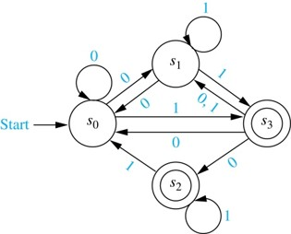
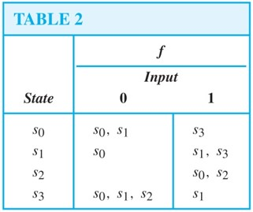
NDFSA
A nondeterministic finite-state automaton M = (S, I, f, s₀, F) consists of a finite set S of states, a finite input alphabet I, a transition function f that assigns a set of states to every pair of state and input (so that f: S × I → P(S)), an initial or start state s₀, and a subset F of S consisting of final (or accepting) states.
We can represent a nondeterministic finite-state automaton using a state table where we give a list of possible next states for each pair of a state and an input value.
We construct a state diagram for a nondeterministic automaton by including an edge from each state to all possible next states, labeling edges with the input or inputs that lead to this transition.
We use the abbreviation NDFSA for a nondeterministic finite-state automaton and DFSA for a deterministic finite-state automata when we needed to distinguish between NDFSA and DFSA.
Example: Find the state diagram for the NDFSA with the state table shown in Table 2. The final states are s₂ and s₃.
Solution:
Jump to long description

Slide 32
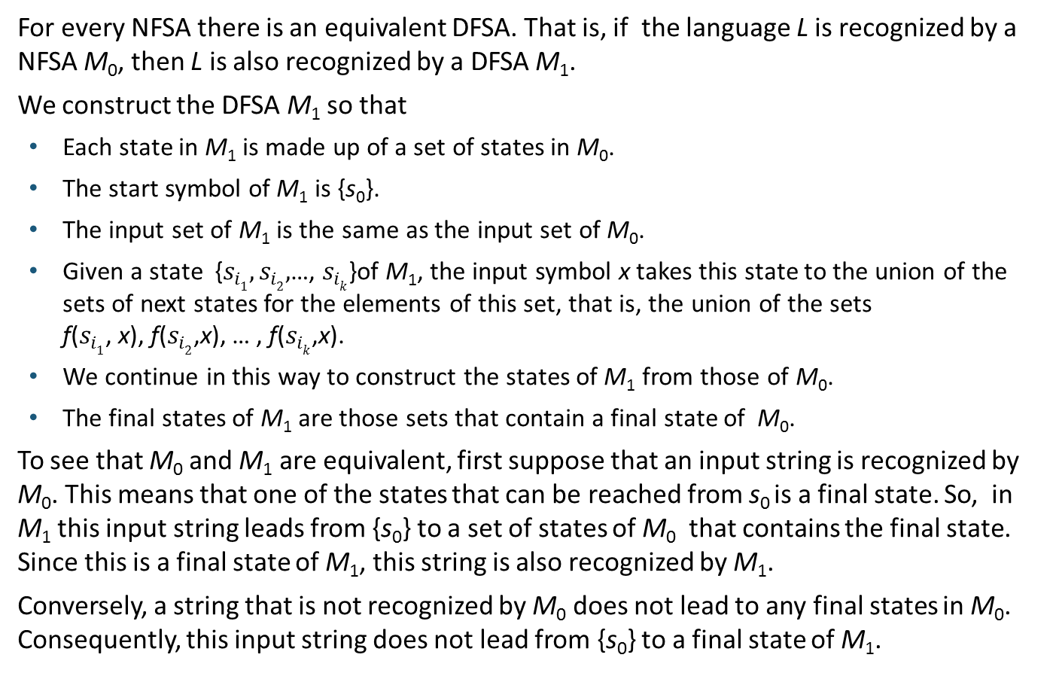
Finding a DFSA Equivalent to a NFSA 1
For every NFSA there is an equivalent DFSA. That is, if the language L is recognized by a NFSA M₀, then L is also recognized by a DFSA M₁.
We construct the DFSA M₁ so that
Each state in M₁ is made up of a set of states in M₀.
The start symbol of M₁ is {s₀}.
The input set of M₁ is the same as the input set of M₀.
Given a state {$s_{i1},s_{i2},$…, $s_{ik}$}of M₁, the input symbol x takes this state to the union of the sets of next states for the elements of this set, that is, the union of the sets f($s_{i1}$, x), f($s_{i2}$,x), … , f($s_{ik}$,x).
We continue in this way to construct the states of M₁ from those of M₀.
The final states of M₁ are those sets that contain a final state of M₀.
To see that M₀ and M₁ are equivalent, first suppose that an input string is recognized by M₀. This means that one of the states that can be reached from s₀ is a final state. So, in M₁ this input string leads from {s₀} to a set of states of M₀ that contains the final state. Since this is a final state of M₁, this string is also recognized by M₁.
Conversely, a string that is not recognized by M₀ does not lead to any final states in M₀. Consequently, this input string does not lead from {s₀} to a final state of M₁.

Slide 33
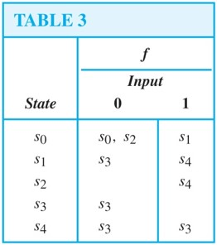
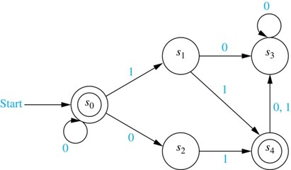
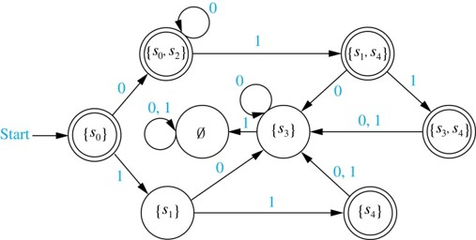
Finding a DFSA Equivalent to a NFSA 2
Example: Find a DFSA that recognizes the same language as the NFSA:
Solution: Following the steps of the procedure described on the previous slide, we obtain the DFSA shown here.
Jump to long description

Slide 34
Language Recognition
Section 13.4

Slide 35
Section Summary 4
Regular Expressions
Kleene’s Theorem
Regular Sets and Regular Grammars
More Powerful Types of Machines

Slide 36
Regular Expressions 1
The regular expressions over a set I are defined recursively by:
Each regular expression represents a set specified by these rules:
Sets represented by regular expressions are called regular sets.

Slide 37
Regular Expressions 2
Example: What are the strings in the regular sets specified by the regular expressions 10*, (10)*, 0 ∪ 01, 0(0 ∪ 1)*, and (0*1)*?
Solution:
TABLE 1
Expression | Strings
10∗ | a 1 followed by any number of 0s (including no zeros)
(10)∗ | any number of copies of 10 (including the null string)
0 ∪ 01 | the string 0 or the string 01
0(0 ∪ 1)∗ | any string beginning with 0
(0∗1)∗ | any string not ending with 0

Slide 38
Finite-State Automata, Regular Sets, and Regular Grammars
In 1956 Kleene established the connection between regular sets and sets recognized by a FSA.
He showed that a set is regular if and only if it is recognized by a FSA. This result is known as Kleene's theorem.
See the text for the lengthy proof of this theorem.
There is a close connection between regular grammars and regular sets.
Specifically, a set is generated by a regular grammar if and only if it is a regular set.
See the text for a proof.
We will give an example of a set that is not regular later in this section by finding a set that is not recognized by an FSA.

Slide 39
A Set Not Recognized by a FSA 1
The set
of all strings consisting of a block of 0s followed
by a block of an equal number of 1s is not regular.
To show that this set is not regular, suppose that this set was regular. Then there would be a NDFSA
recognizing it.
Let N be the number of states in this machine, that is,
M must recognize 0^{N}1^{N} since it is made up of a block of 0s followed by a block of an equal number of 1s.
Let s₀, s₁, s₂,…,s_{2N} be the sequence of states obtained starting at s₀ and using the symbols of 0^{N}1^{N} as input. So,
and s_{2N} is a final state.
Because there are only N states, by the pigeonhole principle at least two of the first N + 1 states s₀, s₂,…,s_{N} must be the same.
Suppose that s_{i} and s_{j} are identical states with
This means that
Hence, there is a loop leading from s_{i} back to
itself, using 0 a total of t times.

Slide 40
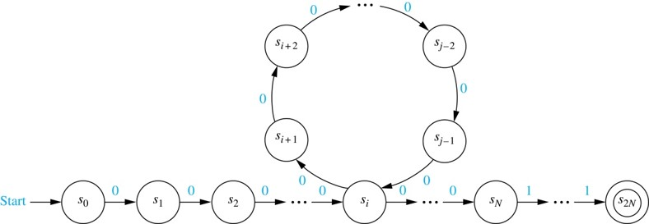
A Set Not Recognized by a FSA 2
Now consider the input string
The string is not of the
correct form and so, it is not recognized by M.
Consequently,
can not be a final state.
However, when we use the string
as input, we end up in the
same state as before, namely, s_{2N}. The reason is that we go through the loop one more time.
This contradiction shows that
is not regular.
Jump to long description

Slide 41
More Powerful Types of Machines
The main limitation of finite-state automata is their finite amount of memory. This has led to the development of more powerful types of machines.
Pushdown Automaton (PDA): includes a stack, which provides unlimited memory. We can use a PDA to recognize
but no PDA recognizes the set
Linear Bounded Automaton (LBA): More powerful than pushdown automata. We can use a LBA to recognize
but there are languages generated by phrase-structure grammars that cannot be recognized by a LBA.
Turing Machine (TM): Yet more powerful machines (to be studied in the next section) which can recognize all languages generated by phrase-structure grammars.

Slide 42
Turing Machines
Section 13.5

Slide 43
Section Summary 5
Definition of Turing Machines
Using Turing Machines to Recognize Sets
Computing Functions with Turing Machines
Different Types of Turing Machines (not currently included in overheads)
The Church-Turing Thesis
Computational Complexity, Computability, and Decidability

Slide 44
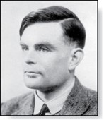
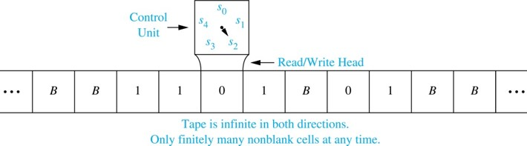
Introduction 3
Alan Mathison Turing (1912-1954)
Informally, a Turing machine consists of a control unit, which at any step is in one of finitely many different states, together with a tape, infinite in both directions, which is divided into cells.
Turing machines have read and write capabilities on the tape as the control unit moves back and forth along this tape, changing states depending on the tape symbol read.
Turing machines are more powerful than finite-state machines because they include additional memory capability.
Turing machines are the most general models of computation; essentially they can do whatever a computer can do.
Jump to long description

Slide 45
Definition of Turing Machines (TM)
A Turing machine T = (S, I, f, s₀) consists of
a finite set S of states,
an alphabet I containing the blank symbol B,
a partial function f from S × I to S × I ×{R,L}, and
a starting state s₀.
For some (state, symbol) pairs the partial function f may be undefined, but for a pair for which it is defined, there is a unique (state, symbol, direction) triple associated to this pair.
The five-tuples corresponding to the partial function in the definition of a TM are called the transition rules of the machine.
At each step, the control unit reads the current tape symbol x. If the control unit is in state s and if the partial function f is defined for the pair (s, x) with f(s, x) = (s′, x′, d), the control unit:
enters the state s′,
writes the symbol x′ in the current cell, erasing x, and
moves right one cell if d = R or moves left one cell if d = L.
This step is written as the five-tuple (s, x, s′, x′, d). Turing machines are defined by specifying a set of such five-tuples. If the partial function f is undefined for the pair (s, x) then T will halt.
At the beginning of its operation a TM is assumed to be in the initial state s₀ and to be positioned over the leftmost nonblank symbol on the tape. This is the initial position of the machine.

Slide 46
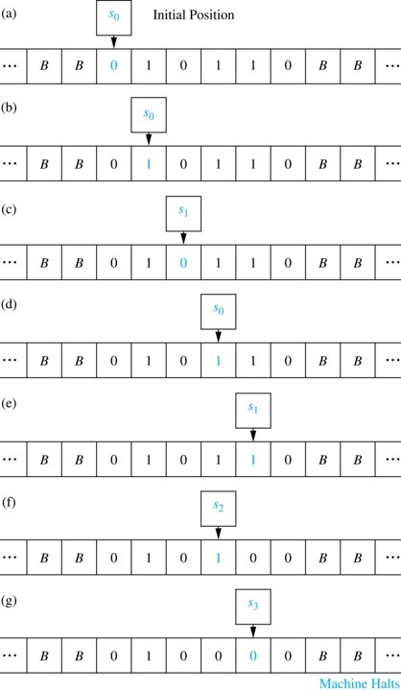
A TM in Operation
Example: What is the final tape when the TM T defined by the seven five-tuples (s₀, 0, s₀, 0, R), (s₀, 1, s₁, 1, R), (s₀, B, s₃, B, R), (s₁, 0, s₀, 0, R), (s₁, 1, s₂, 0, L), (s₁, B, s₃, B, R), and (s₂, 1, s₃, 0, R) is run on the tape shown here in (a)?
Solution: The transitions of this TM are shown to the right. The final tape is shown in (g).
Jump to long description

Slide 47
Using TM to Recognize Sets 1
Let V be a subset of an alphabet I. A TM T = (S, I, f, s₀) recognizes a string x in V* if and only if T, starting in the initial position when x is written on the tape, halts in a final state.
T is said to recognize a subset A of V* if x is recognized by T if and only if x belongs to A.
Note that to recognize a subset A of V* we can use symbols not in V. This means that the input alphabet I may include symbols not in V. We will see that these extra symbols are used as markers.
A TM operating on a tape containing the symbols of a string x in consecutive cells, does not recognize x if it does not halt or halts in a state that is not final.

Slide 48
Using TMs to Recognize Sets 2
In Section 13.4 we showed that there is no DFA that recognizes the set the set
We will now construct a TM that recognizes this set.
We use an auxiliary tape symbol M as a marker, and specify that V = {0, 1} and I = {0, 1, M}.
Our TM has one final state, s₆ . The TM successively replaces a 0 at the leftmost position of the string with an M and a 1 at the rightmost position of the string with an M, sweeping back and forth, terminating in a final state if and only if the string consists of a block of 0s followed by a block of the same number of 1s.
The five-tuples are (s₀, 0, s₁, M, R), (s₁, 0, s₁, 0, R), (s₁, 1, s₁, 1, R), (s₁, M, s₂, M, L), (s₁, B, s₂, B, L), (s₂, 1, s₃, M, L), (s₃, 1, s₃, 1, L), (s₃, 0, s₄, 0, L), (s₃, M, s₅, M, R), (s₄, 0, s₄, 0, L), (s₄, M, s₀, M, R), and (s₅, M, s₆, M, R).
For example, the string 000111 would successively become M00111, M0011M, MM011M, MM01MM, MMM1MM, MMMMMM as the machine operates until it halts.

Slide 49
Computing Functions with TMs 1
A Turing machine can be used to compute the values of a partial function.
Suppose that the TM T, when given the string x as input, halts with the string y on its tape. We can then define T(x) = y.
To consider a TM as a computer of functions from the set of k-tuples of nonnegative integers to the set of nonnegative integers, we use the unary representation of integers.
A nonnegative integer n is represented by a string of n + 1 1s. So, 0 is represented by 1, 5 by 111111, etc.
To represent an input that is a k-tuple of integers, we represent each integer in the k-tuple separately and separate these representations using asterisks. For example, (2,0,1,3) is represented by 111*1*11*1111.
Constructing a Turing machine that computes a particular function can be extremely complicated. Fortunately, the ability of Turing machines to compute functions is of theoretical, rather than practical, interest.

Slide 50
Computing Functions with TMs 2
To construct a TM T that computes the function
we first represent the pair (n₁,n₂) by a string of n₁ + 1 1s followed by an asterisk, followed by n₂ + 1 1s.
The machine starts at the leftmost 1 of the input string, and proceeds to erase this 1.
If the next character is an asterisk, n₁ = 0. In this case, it replaces the asterisk with a blank and halts.
Otherwise, it erases the next 1, and then passes over the remaining 1s, until it comes to the asterisk.
The asterisk is then replaced by a 1.
The five-tuples defining this Turing machine are: (s₀, 1, s₁, B, R), (s₁, ∗, s₃, B, R), (s₁, 1, s₂, B, R), (s₂, 1, s₂, 1, R), (s₂, ∗, s₃, 1, R).

Slide 51
The Church-Turing Thesis
The Church-Turing Thesis says that given any problem that can be solved with an effective algorithm, there is a TM that can solve this problem.
It is called a thesis rather than a theorem because the concept of solvability by an effective algorithm is informal and imprecise, as opposed to the concept of solvability by a TM, which is formal and precise.

Slide 52
Decidability and Complexity
A decision problem asks whether statements from a particular class of statements are true. Decision problems are also known as yes-or-no problems.
Consider the question for a particular integer n, “Is n prime?” The answer is "yes" or "no.“
The halting problem is the decision problem that asks whether a Turing machine T eventually halts when given an input string x.
When there is an effective algorithm that decides whether instances of a decision problem are true, we say that this problem is solvable or decidable.
In Section 3.5, an algorithm was given for determining whether a positive integer n is prime by checking whether it is divisible by primes not exceeding its square root.
However, if no effective algorithm exists for solving a problem, then we say the problem is unsolvable or undecidable.
The halting problem is an unsolvable decision problem (proved in Section 3.1). That is, no TM exists that, when given an encoding of a TM T and its input string x as input, can determine whether T eventually halts when started with x written on its tape.
A function that can be computed by a TM is called computable and a function that cannot be computed by a TM is called uncomputable.
The busy beaver function, which when given a positive integer n gives the maximum number of 1s that a TM with n states and alphabet {1,B} may print on an initially blank tape is uncomputable (see Exercise 35 in Section 13.5).

Slide 53
The Classes P and NP 1
In a nondeterministic Turing machine (NDTM), the restriction that no two transition rules begin with the same pair (s, x) is eliminated.
Hence, there may be more than one transition rule beginning with each (state, tape symbol) pair, so that there may be a choice as to which rule to use at each step.
A NDTM T recognizes a string x if and only if there exists some sequence of transitions of T that ends in a final state when the machine starts in the initial position with x written on the tape.

Slide 54
The Classes P and NP 2
A decision problem is in P, the class of polynomial-time problems, if it can be solved by a deterministic Turing machine in polynomial time in terms of the size of its input.
That is, a decision problem is in P if there is a deterministic Turing machine T that solves the decision problem and a polynomial p(n) such that for all integers n, T halts in a final state after no more than p(n) transitions whenever the input to T is a string of length n.
A decision problem is in NP, the class of nondeterministic polynomial-time problems, if it can be solved by a nondeterministic Turing machine in polynomial time in terms of the size of its input.
That is, a decision problem is in NP if there is a nondeterministic Turing machine T that solves the problem and a polynomial p(n) such that for all integers n, T halts for every choice of transitions after no more than p(n) transitions whenever the input to T is a string of length n.
Problems in P are called tractable, whereas problems not in P are called intractable.

Slide 55
The Classes P and NP 3
For a problem to be in NP, it is necessary only that there be a NDTM that when given a true statement from the set of statements addressed by the problem, can verify its truth in polynomial time by making the correct guess at each step.
The problem of determining whether a given graph has a Hamilton circuit is an NP problem, because a NDTM can easily verify that a simple circuit in a graph passes through each vertex exactly once.
It can do this by making a series of correct guesses corresponding to successively adding edges to form the circuit.

Slide 56
Wrapping Everything up with a Millennium Problem
Because every DTM can also be a considered to be a NDTM, where each (state, tape symbol) pair occurs in exactly one transition rule,
The most famous open question in theoretical CS, and one of the millennium problems with a $1,000,000 prize, is whether every problem in NP is also in P, that is, whether P = NP.
There is an important class of problems, known as NP-complete problems, where a problem is in this class if it is the class NP and if this problem was also in the class P, then every problem in NP must also be in P.
That is, a problem is NP-complete if the existence of a polynomial-time algorithm for solving it implies the existence of a polynomial-time algorithm for every problem in NP.
We have studied several problems that can be shown to be NP-complete in this text, including determining whether a simple graph has a Hamilton circuit and determining whether a proposition in n variables is a tautology.
This concludes our introduction to discrete mathematics, but it should come as no surprise that there is a lot more to learn!

Slide 57
Appendix of Image Long Descriptions

Slide 58
Derivation Trees- Appendix
The root of this tree is sentence. The nodes of the root are noun phrase and verb phrase. Noun phrase is divided into article, adjective, and noun. Article is the, adjective is hungry, noun is rabbit. Verb phrase is divided into verb and adverb. Verb is eats. Adverb is quickly.
Jump to the image

Slide 59
An Example of a Finite-State Machine with Output 2 - Appendix
There are 7 states, S0 through S6. S0 is the start state. The states are presented as circles. Arrows point from S0 to S1, the arrow is labeled 5, N. From S0 to S2, labeled 10, N. From S0 to S5, labeled 25, N. From S1 to S2, labeled 5, N. From S1 to S3, labeled 10, N. From S1 to S6, labeled 25, N. From S2 to S3, labeled 5, N. From S2 to S4, labeled 10, N. From S2 to S6, labeled 25, 5. From S3 to S4, labeled 5, N. From S3 to S5, labeled 10, N. From S3 to S6, labeled 25,10. From S4 to S5, labeled 5, N. From S4 to S6, labeled 10, N. From S4 to S6, labeled 25, 15. There are 3 arrows from S5 to S6, labeled 5, N, 10, 5, and 25, 20. There are 2 arrows from S6 to S0, labeled O, orange juice and R, apple juice. The states, S0 through S5 have a loops, each labeled R, N, O, N. State S6 has 3 loops, labeled 5, 5, 10, 10, and 25, 25.
Jump to the image

Slide 60
FSMs with Outputs - Appendix
There are 4 states, S0 through S3. S0 is the start state. Arrows point from S0 to S1, the arrow is labeled 0, 1. From S1 to S0, labeled 1, 1. From S1 to S3, labeled 0, 1. From S2 to S1, labeled 0, 0. From S3 to S1, labeled 1, 0. From S3 to S2, labeled 0, 0. There are loops at S0 labeled 1, 0, and at S2 labeled 1, 1.
Jump to the image

Slide 61
Unit-delay Machine - Appendix
There are 3 states, S0 through S2. S0 is the start state. Arrows point from S0 to S1, the arrow is labeled 1, 0. From S0 to S2, labeled 0, 0. From S1 to S2, labeled 0, 1. From S2 to S1, labeled 1, 0. There are loops at S1 labeled 1, 1, and at S2 labeled 0, 0.
Jump to the image

Slide 62
Addition Machine - Appendix
There are 2 states, S0 and S1. S0 is the start state. Arrows point from S0 to S1, the arrow is labeled 11, 0. From S1 to S0, labeled 00, 1. There are 3 loops at S0, labeled 00, 0. 01, 1, and 10, 1. There are 3 loops at S1, labeled 01, 0. 10, 0, and 11, 1.
Jump to the image

Slide 63
Finite-State Automata (FSA) - Appendix
There are 4 states, S0 through S3. S0 is the start state. Arrows point from S0 to S1, the arrow is labeled 1. From S1 to S0, labeled 0. From S1 to S2, labeled 1. From S2 to S0, labeled 0, 1. From S3 to S1, labeled 1. From S3 to S2, labeled 0. There is a loop at S0, labeled 0. States S0 and S3 are double circled.
Jump to the image

Slide 64
Language Recognition by FSAs 1 - Appendix
Diagram M1. There are 2 states, S0 and S1. S0 is the start state. Arrows points from S0 to S1, the arrow is labeled 0. There is a loop at S0, labeled 1. State S0 is double circled. Diagram M2. There are 4 states, S0 through S3. S0 is the start state. Arrows point from S0 to S1, the arrow is labeled 0. From S0 to S2, labeled 1. From S1 to S2, labeled 1. From S1 to S3, labeled 0. From S2 to S3, labeled 0, 1. There is a loop at S3, labeled 0, 1. State S2 is double circled. Diagram M3. There are 4 states, S0 through S3. S0 is the start state. Arrows point from S0 to S1, the arrow is labeled 1. From S1 to S2, labeled 1. From S1 to S3, labeled 0. There are loops at S0 labeled 0, at S2 labeled 0, 1, and at S3 labeled 0, 1. States S0 and S3 are double circled.
Jump to the image

Slide 65
Language Recognition by FSAs 2 - Appendix
There are 4 states, S0 through S3. S0 is the start state. Arrows point from S0 to S1, the arrow is labeled 0. From S0 to S3, labeled 1. From S1 to S2, labeled 0. From S1 to S3, labeled 1. There are loops at S2 labeled 0, 1, and at S3 labeled 0, 1. State S2 is double circled.
Jump to the image

Slide 66
Language Recognition by FSAs 3 - Appendix
There are 3 states, S0 through S2. S0 is the start state. Arrows point from S0 to S1, the arrow is labeled 0. From S1 to S0, labeled 1. From S1 to S2, labeled 0. There are loops at S0 labeled 1, and at S2 labeled 0, 1. State S2 is double circled.
Jump to the image

Slide 67
NDFSA - Appendix
There are 4 states, S0 through S3. S0 is the start state. Arrows point from S0 to S1, the arrow is labeled 0. From S0 to S3, labeled 1. From S1 to S0, labeled 0. From S1 to S3, labeled 1. From S3 to S0, labeled 0. From S3 to S1, labeled 1. From S3 to S2, labeled 0. From S2 to S0, labeled 1. There are loops at S0 labeled 0, at S1 labeled 1, and at S2 labeled 1. States S2 and S3 are double circled.
Jump to the image

Slide 68
Finding a DFSA Equivalent to a NFSA 2 - Appendix
(Figure 7) There are 5 states, S0 through S4. S0 is the start state. Arrows point from S0 to S1, the arrow is labeled 1. From S0 to S2, labeled 0. From S1 to S3, labeled 0. From S1 to S4, labeled 1. From S2 to S4, labeled 1. From S4 to S3, labeled 0, 1. There are loops at S0 labeled 0, and at S3 labeled 0. States S0 and S4 are double circled.
(Figure 8) There are 8 sets. S0, S1, S3, S4, S0 and S2, S1 and S4, S3 and S4, and an empty set. S0 is the start set. Arrows point from S0 to the set of S0 and S2, the arrow is labeled 0. From S0 to S1, labeled 1. From S1 to S3, labeled 0. From S1 to S4, labeled 1. From S3 to empty set, labeled 1. From S4 to S3, labeled 0, 1. From the set of S0 and S2 to the set of S1 and S4, labeled 1. From the set of S1 and S4 to S3, labeled 0. From the set of S1 and S4 to the set of S3 and S4, labeled 1. From the set of S3 and S4 to S3, labeled 0, 1. There are loops at S3 labeled 0, at the set of S0 and S2 labeled 0, and at the empty set labeled 0, 1. Sets S0, S4, S0 and S2, S1 and S4, and S3 and S4 are double circled.
Jump to the image

Slide 69
A Set Not Recognized by a FSA 2 - Appendix
There are 3 states, S0 through S2N. S0 is the start state. Arrows point from S0 to S1. From S1 to S2 and so on to S N. Each arrow is labeled 0. Arrows point from S N to S N plus 1 and so on to S2N. Each arrow is labeled 1. There is a loop at S I, consisting of S I plus 1, S I plus 2 and so on to S J minus 1. Arrows point from S I to S I plus 1. From S I plus 1 to S I plus 2 and so on to S J minus 2. From S J minus 2 to S J minus 1. From S J minus 1 to S I. Each arrow is labeled 0. State S2N is double circled.
Jump to the image

Slide 70
Introduction 3 - Appendix
There is a tape, that is infinite in both directions. The tape is divided into equal cells. The cell can be empty or the input data can be written to it. But the number of non-empty cells at any given time is finite. There is a control unit, also called a read or write head, capable of being in one of many states. The number of possible states of the control unit is finite and precisely defined. The control unit can move left and right on the tape, read and write data to cells. The data in the tape is B, B, 1, 1. 0, 1, B, 0. 1, B, B.
Jump to the image

Slide 71
A TM in Operation - Appendix
There is a tape with the data and a control unit. Step A. Initial position. The control unit is in state S0, and it is above the third cell with value 0. Step B. The control unit moves one cell to the right, the value of which is 1. Step C. The control unit changes its state to S1 and moves one cell to the right, the value of which is 0. Step D. The control unit changes its state to S0 and moves one cell to the right, the value of which is 1. Step E. The control unit changes its state to S1 and moves one cell to the right, the value of which is 1. Step F. The control unit changes its state to S2, writes 0 in this cell, and moves one cell to the left, the value of which is 1. Step G. The control unit changes its state to S3, writes 0 in this cell, and moves one cell to the left, the value of which is 0.
Jump to the image

